Slide 1
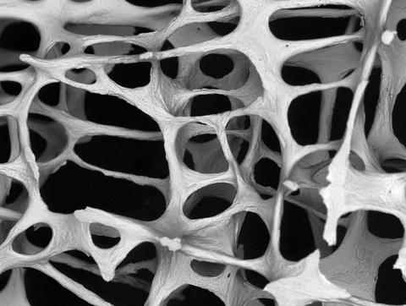
Skeletal system: cells and tissues
AEHBY ATAR Human Biology

Slide 2
Review
Give an example of a flat, long and irregular bone.
Name the agonist and antagonist for flexion of the elbow.
Sketch and label the structure of a villi. Explain the function of the lacteal.
Explain how blood flow through the alveolar capillaries assist with gas exchange.
Sketch the four types of tissues and identify the main features of each.

Slide 3
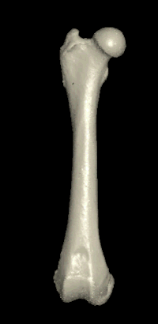
Learning Intentions
The skeletal framework of the body consists of bone and cartilage and is facilitated by the structure and function at cell and tissue levels.

Slide 4
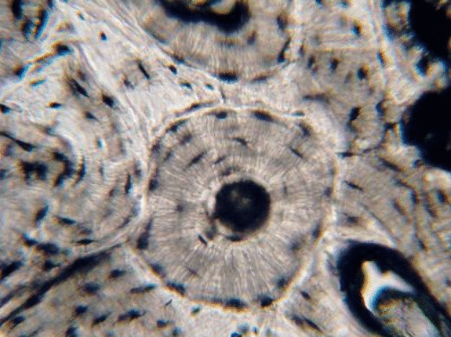
Success Criteria
Classify bone and cartilage as connective tissue.
Label bone cells as osteocytes and cartilage cells as chondrocytes.
Describe the microscopic structure of compact and spongy bone.
Describe three types of cartilage found in the skeletal system.
Explain how bone and cartilage obtain nutrients and remove wastes, repair and grow.

Slide 5
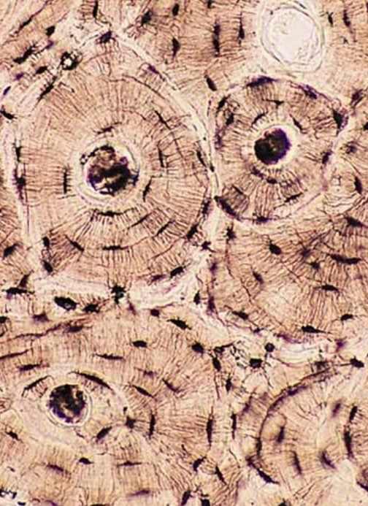
Microscopic structure of bone
Bone is classified as connective tissue, because it has cells (osteocytes) separated from each other by a large amount of extra-cellular mineral matrix.

Slide 6
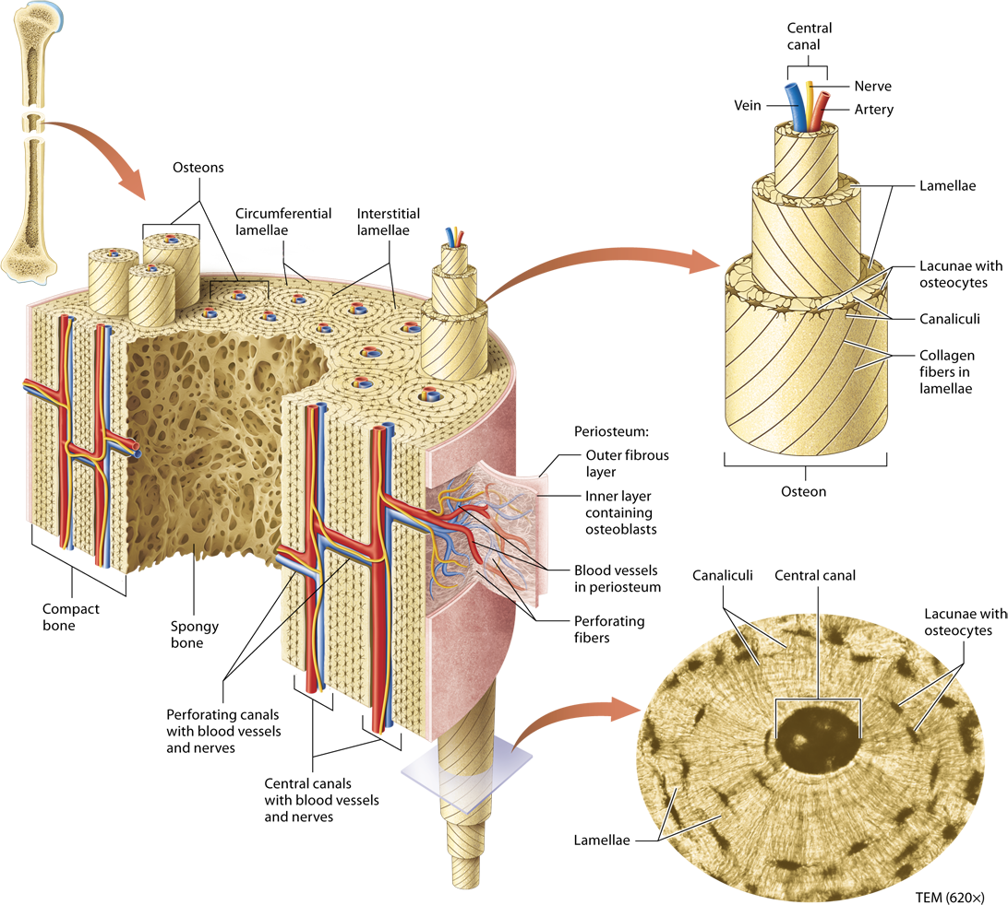

Slide 7
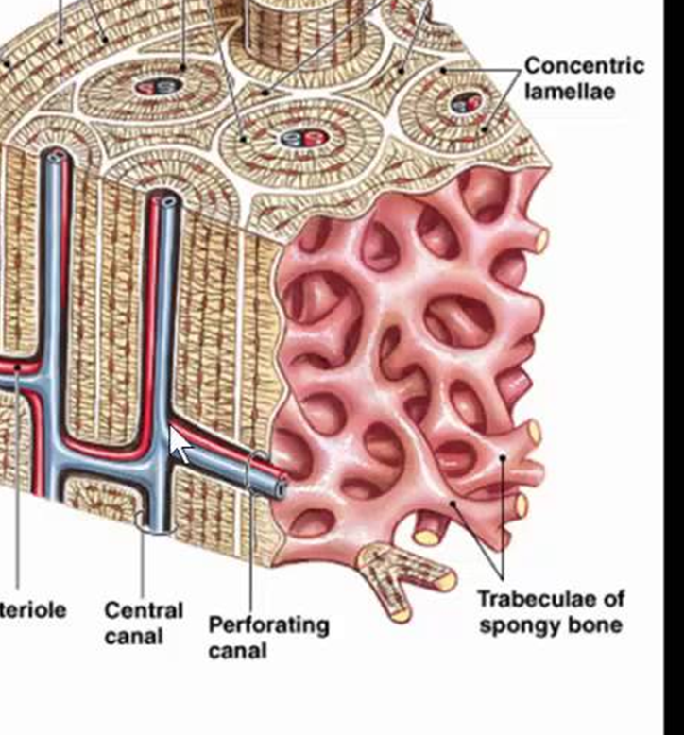


Slide 8
Microscopic structure of cartilage
Cartilage is classified as connective tissue, because it has cells (chrondocytes) separated from each other by a large amount of extra-cellular matrix of fibrous protein (collagen) and firm protein-carbohydrate complex (chondrin). Three types of cartilage in the skeletal system depend on the thickness of the fibres.

Slide 9
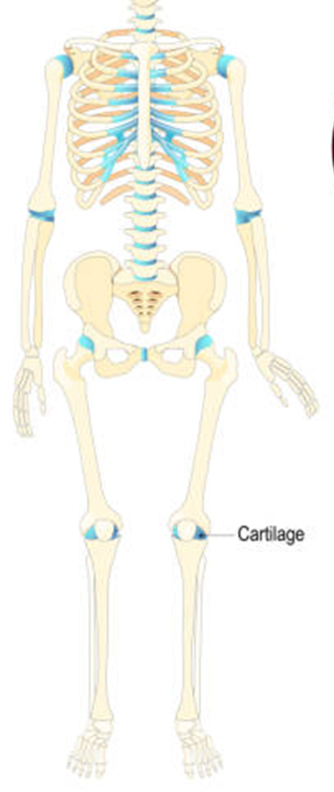
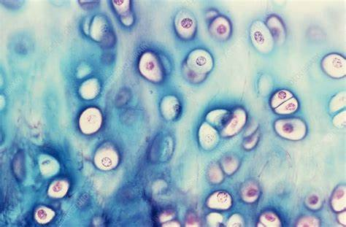
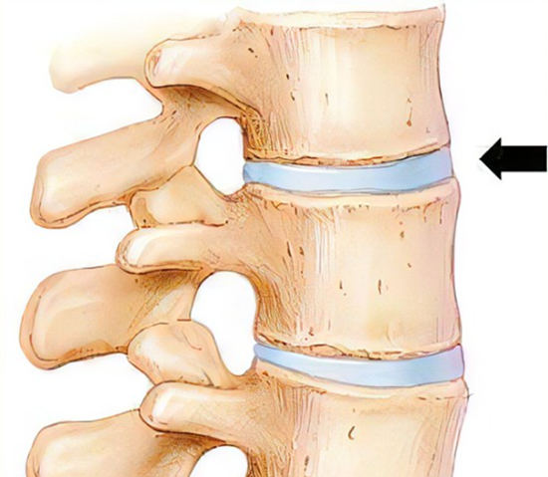
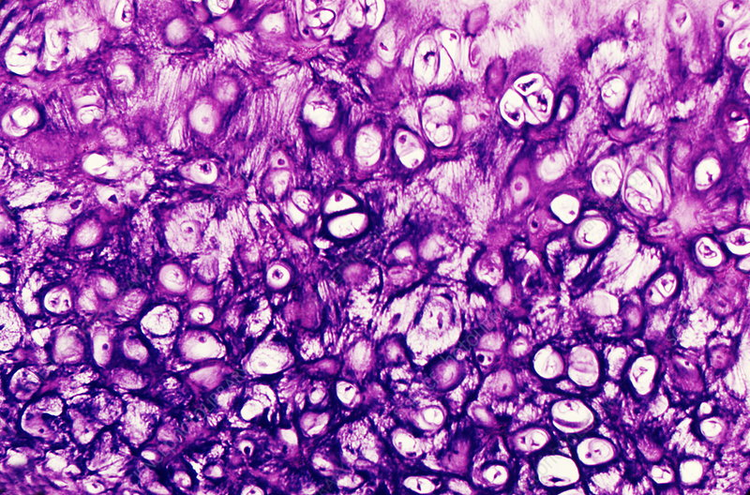
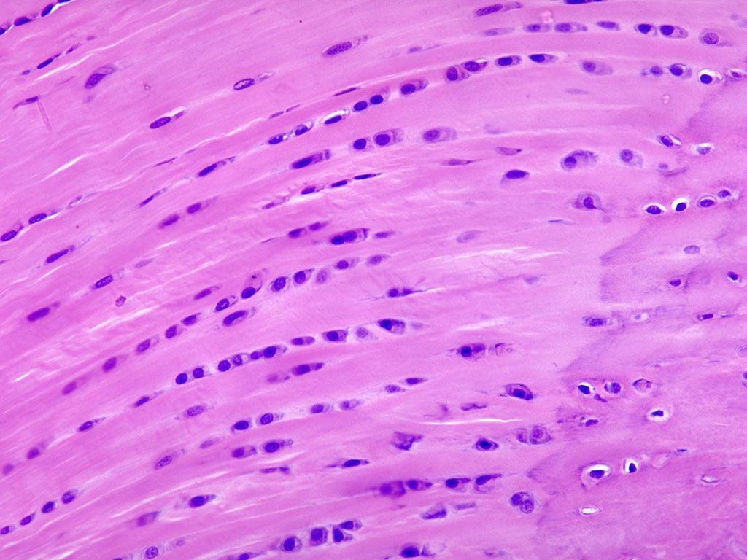
Types of cartilage
Hyaline: Closely packed fibres within the matrix provide strength and flexibility, eg ends of bones within moveable joints.
Elastic: Fibres not so closely packed so more flexible, eg ears.
Fibrous: Coarse, thick bundles of fibres can be compressed slightly to absorb impact, eg intervertebral discs of spinal column.

Slide 10
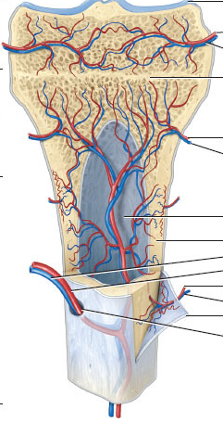
Blood supply
While bone is richly supplied with blood vessels, cartilage contains no blood vessels.
All nutrients and wastes must be transported by diffusion through the matrix, from blood vessels in nearby tissues.

Slide 11
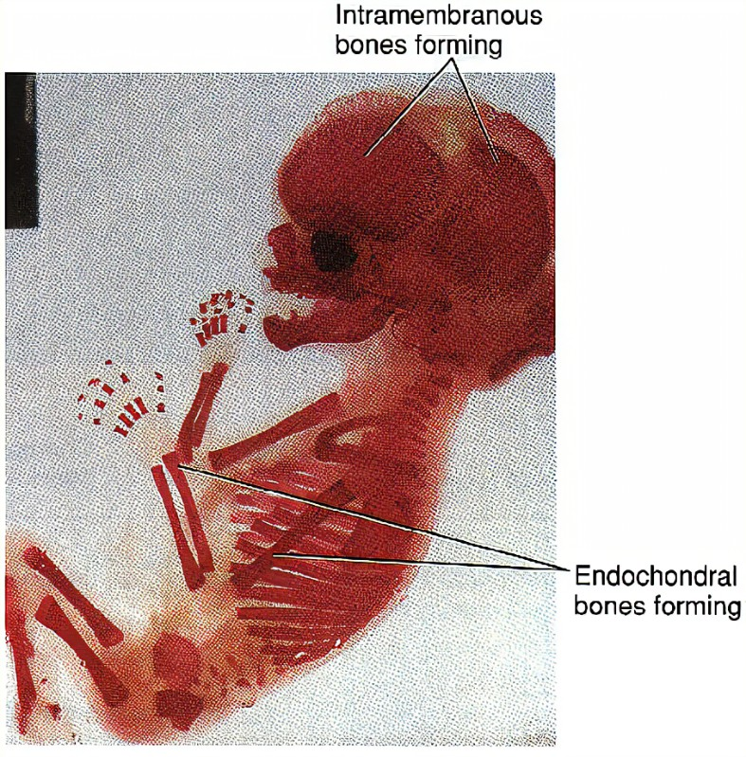
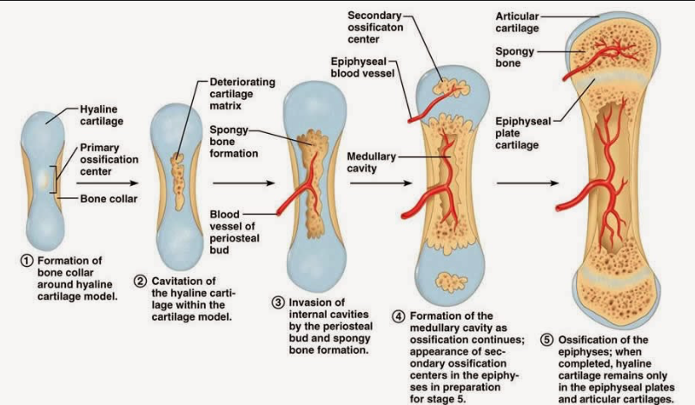
Growth and repair
Bones start as cartilage which is gradually ossified as the individual ages to adulthood. Bones are continually remodelling and can repair themselves.
Cartilage is produced by chondroblasts which produce the matrix around themselves and then mature into chondrocytes. It does not remodel and injured cartilage is very slow to repair.

Slide 12
Success Criteria
Classify bone and cartilage as connective tissue.
Label bone cells as osteocytes and cartilage cells as chondrocytes.
Describe the microscopic structure of compact and spongy bone.
Describe three types of cartilage found in the skeletal system.
Explain how bone and cartilage obtain nutrients and remove wastes, repair and grow.

